Slide 1
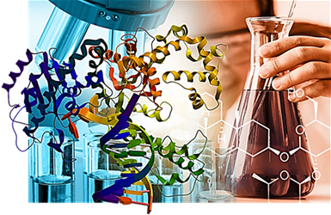
Lesson #1: Chemistry of Life

Slide 2
Learning goals
Be able to list the different parts of an atom
Be able to explain the relationship between electron arrangement and chemical reactivity
Be able to differentiate between an ionic and covalent bond
Be able to identify whether a bond will be polar, non-polar, or ionic based on electronegativity
Be able to differentiate between the different types of intermolecular forces
Be able to predict the type of intermolecular force that would occur between different molecules
Be able to rank all forces in terms of relative strength of attraction
Be able to explain how geckos are able to climb vertical surfaces

Slide 3
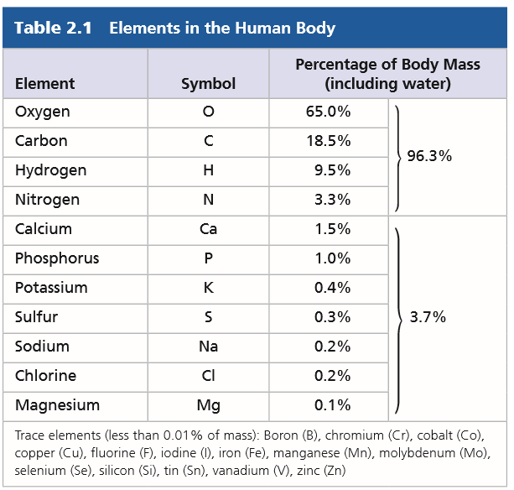
What’s the matter with you?
Living organisms are composed of an endless assortment of matter
Matter is made up of elements
20 – 25% are essential elements that an organism needs to live a healthy life and reproduce
Notes:
An element is a substance that cannot be broken down to other substances by chemical reactions
Trace elements are required by an organism in only minute quantities → ex: Iron (hemoglobin and RBCs → deficiency and anemia)

Slide 4
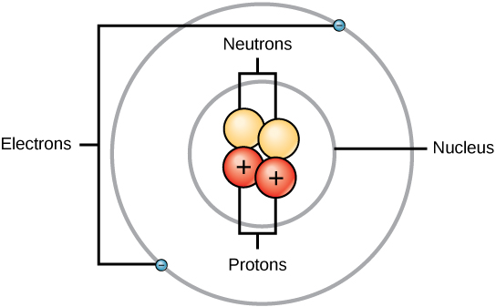
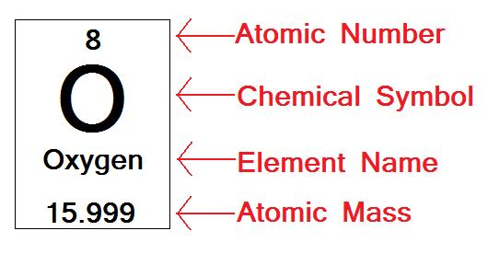
Atomic structure
An element’s properties depend on the structure of its atoms …
The atom is the smallest unit of matter
Nucleus is composed of protons (+) and neutrons
Electrons (-) outside the nucleus
Atomic mass = number of protons and neutrons
Atomic number = number of protons

Slide 5
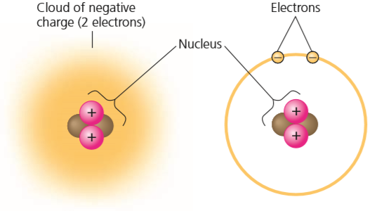
Electron arrangement
Electrons move around the nucleus in specific energy shells
The rapidly moving electrons form a “cloud” of negative charge around the nucleus
It is the attraction between opposite charges that keeps the electrons close to the nucleus
Electrons determine how the atoms will interact
Chemical reactions involve changes in distribution of electrons among atoms

Slide 6
Valence electrons
The chemical behaviour of an atom depends mostly on the number of electrons in its outermost shell, valence shell
Atoms with incomplete valence shells can interact with certain other atoms in such a way that each partner atom completes its valence shell: The atoms either share or transfer valence electrons

Slide 7
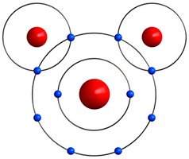
Chemical bonds
Electrons can be “shared” between atoms or “transferred” to other atoms
These interactions usually result in atoms staying close together, held by attractions called chemical bonds
Important for biological molecules:
Ionic bonds
Covalent bonds
Intermolecular forces

Slide 8
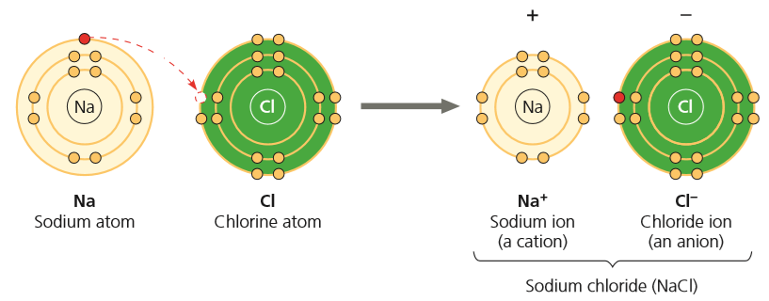
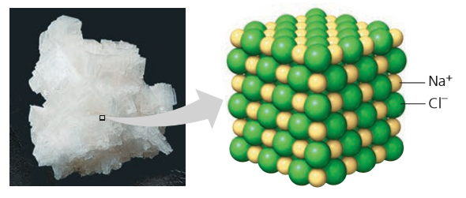
Ionic bonds
An ionic bond forms between atoms that have lost or gained electrons to become charged
Atoms that have lost or gained electrons are called ions
Ions of opposite charge – one positive and the other negative – are strongly attracted to on another, and this attraction leads to an ionic bond (electrostatic forces)
Ionic compounds do not form individuals molecules … they form crystal lattice networks!
Notes:
In some cases, two atoms are so unequal in their attraction for valence electrons that the more electronegative atom strips an electron completely away from its partner

Slide 9
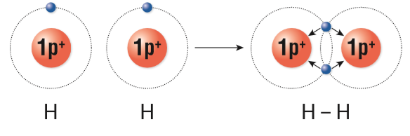
Covalent bonds
Covalent bonds form when atoms share one or more pairs of valence electrons
When the bonds form, they give the atom a full complement of electrons in the valence shell
Ex: H₂
Notes:
Each hydrogen atom is now associated with 2 electrons in what amounts to a completed valence shell

Slide 10
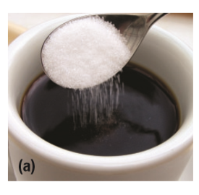
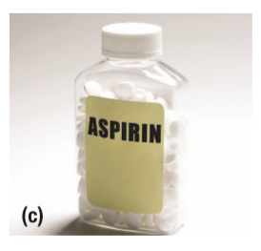
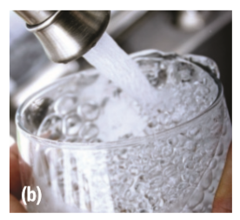
Covalent Compounds
Covalent compounds are all around you: in the air that you breathe and the substances that you eat and drink!
Dissolved carbon dioxide gas CO₂
Table sugar C₁₂H₂₂O₁₁
Aspirin (acetylsalicylic acid) C₉H₈O₄

Slide 11
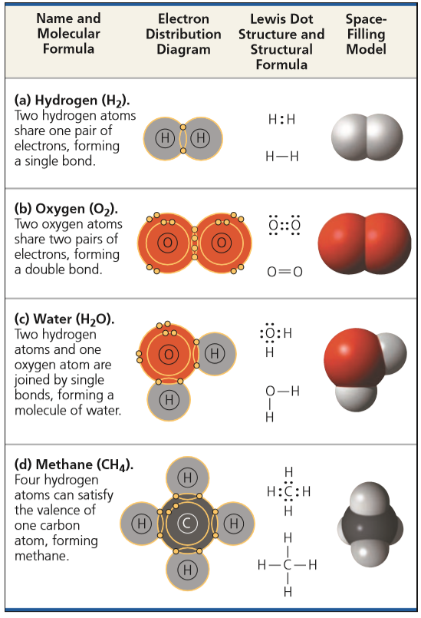

Slide 12
Covalent bonds and electronegativity
The strength of a covalent bond depends on the electronegativity of the atoms involved in the sharing of the electron pair
Electronegativity is the measure of an atom’s attraction for additional electrons

Slide 13
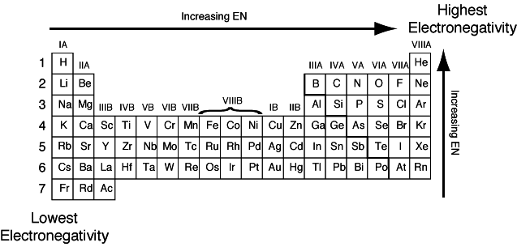
Intramolecular Bonding & Electronegativity
Electronegativity (E_{N}) is a measure of an atom’s attraction for the electrons within a bond that exists between 2 atoms
The more electronegative an atom, the more strongly it pulls the shared electrons toward itself
Notes:
Electronegativity is influenced by the atomic number and the distance between the valence electrons and the nucleus of an atom
Electronegativity increases as the distance between the electrons and the nucleus decreases

Slide 14
Intramolecular Bonding & Electronegativity
The difference in E_{N} between two atoms determines the type of bonding
Electronegativity difference (ΔE_{N}) scale:
covalent
ionic (>1.7 and up)
“non-polar” (0 - 0.4)
polar (> 0.4 - 1.7)
*
0.4
1.7
2.0
*If (ΔE_{N} ) is between 1.7 and 2.0 and only non-metals are involved…it is still polar covalent!
eg. Sodium bromide (ΔE_{N} = 1.9) →
Hydrogen fluoride (ΔE_{N} = 1.9) →
IONIC BOND
POLAR COVALENT BOND
Notes:
In a covalent bond between two atoms of the same element, the electrons are shared equally because the two atoms have the same electronegativity → non-polar covalent bond
However, when an atom is bonded to a more electronegative atom, the electrons of the bond are not shared equally → polar covalent bond

Slide 15
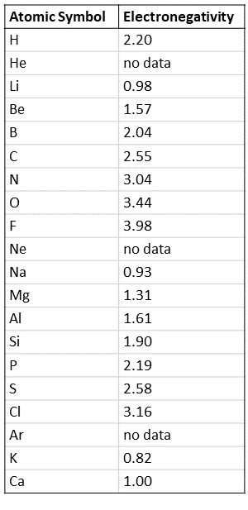
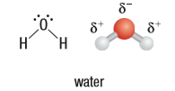
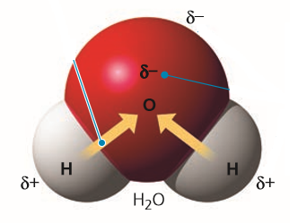
Polarity
The atom that attracts the valence electrons more strongly carries a partial negative charge, 𝛿⁻, which results in the other atom carrying a partial positive charge, 𝛿⁺
Since the atoms carry partial charges, the whole molecule may have a non-uniform charge distribution
This is the polarity of the molecule
(∆En = 3.44 – 2.20 = 1.24)

Slide 16
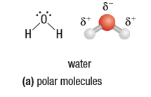
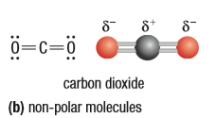
Overall Polarity
Is determined by:
ΔE_{N} between the bonded atoms
the symmetry of the molecule
Notes:
Water molecule has an asymmetrical shape, with the oxygen atom positioned at a bend in the molecule, the partial charges on the atoms create an unequal distribution of charges on the molecule as a whole
Carbon dioxide contains two double bonds with oxygen, making its three-dimensional arrangement appear linear
The bonds are polar, but the symmetry of the molecule results in a balanced distribution of the charges → overall, the molecule is non-polar

Slide 17
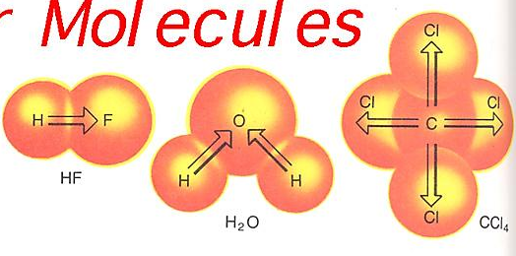
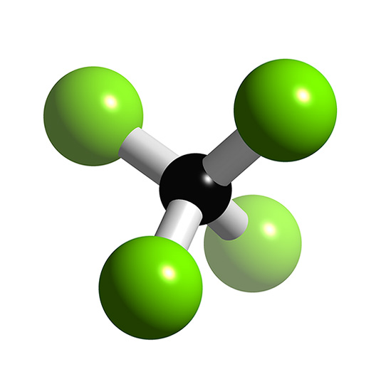
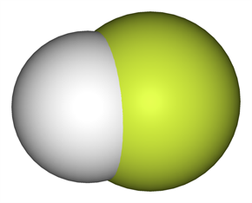
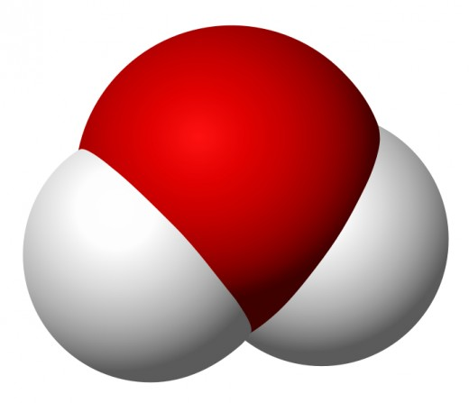
Polar or non-polar?
CCl₄
Both HF and H₂O are polar molecules because the arrangement of the polar bonds is not symmetrical
CCl₄ molecule is non-polar in spite of the fact that it contains four polar bonds

Slide 18
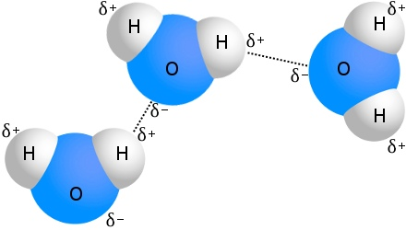
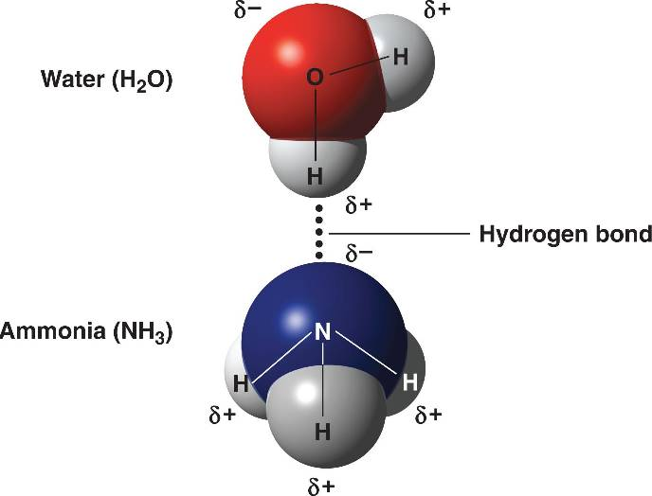
Intermolecular “Van der Waals” forces
Are weak forces that help molecules adhere or interact with each other in cell processes, and will also determine the shapes of large molecules like DNA and proteins
There are several types that act between organic molecules:
Hydrogen bonds: A hydrogen atom that is covalently bonded to a strongly electronegative atom in one molecule can become attracted to a strongly electronegative atom (F, O, or N) in a different molecule
Notes:
F, O, and N = very electronegative 4.0, 3.4, and 3.0

Slide 19
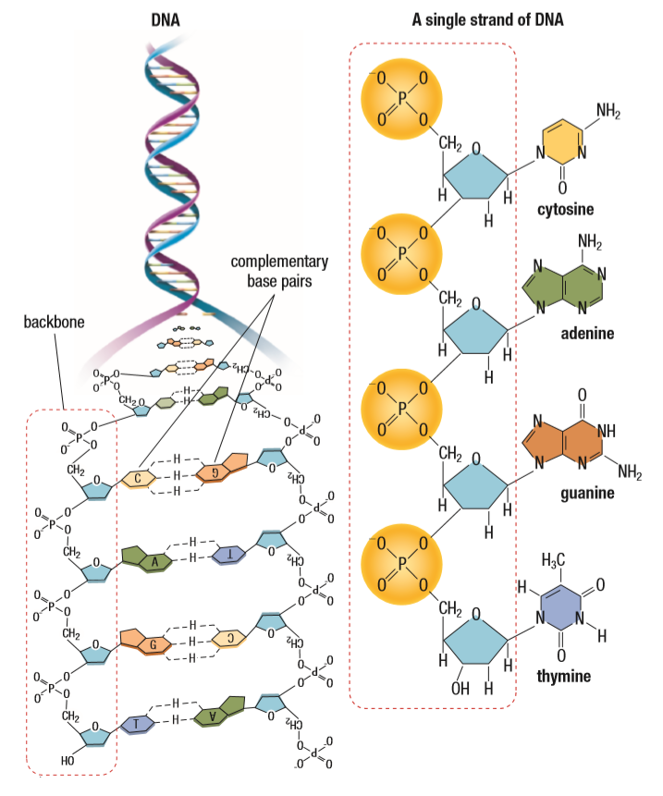
Hydrogen bonding
Hydrogen bonds are the most biologically significant form of van der Waals forces
Individual hydrogen bonds are weak compared with ionic and covalent bonds, but they can be very significant when they occur in large numbers
A large number of hydrogen bonds are collectively strong, and they lend stability to the three-dimensional structure of large molecules, such as proteins and DNA

Slide 20
recall … dipole
A dipole is a separation of electric charges within a bond or molecule
Results in a region with a with δ⁺ and a region with a δ⁻
It occurs when two atoms in a bond have different electronegativities, meaning one attracts electrons more strongly than the other

Slide 21
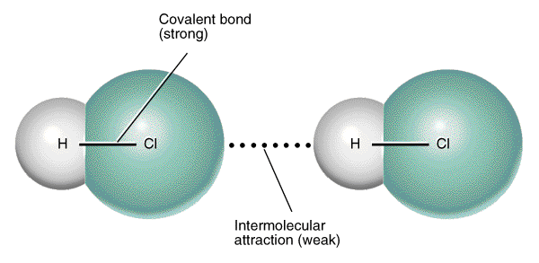
Other van der waals forces
Dipole-dipole interactions: attractive forces between the positive end of one polar molecule and the negative end of another polar molecule
Dipole-dipole interactions play a significant role in determining the shape of a protein like hemoglobin!
𝛿⁻
𝛿⁺
Notes:
Dipole: when 2 electrical charges, of opposite sign, are separated by a distance

Slide 22
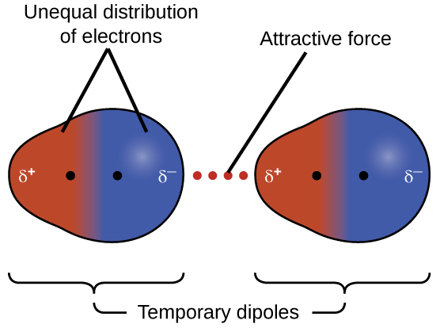
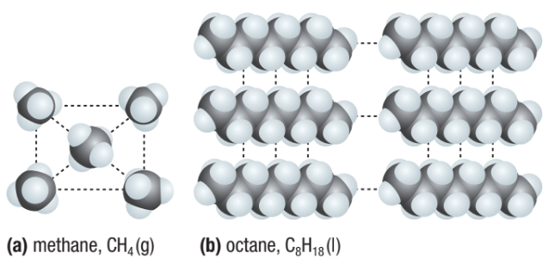
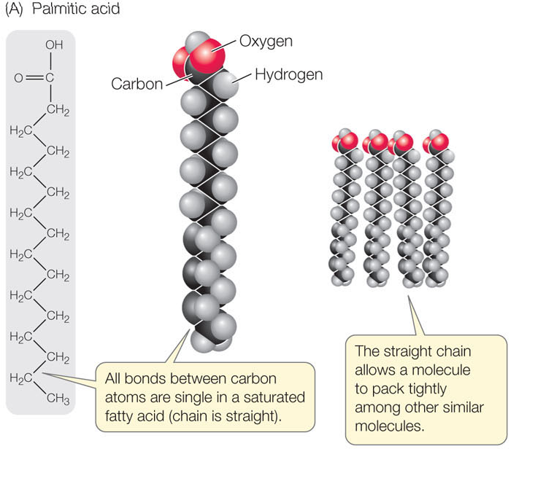
Other van der waals forces:
London dispersion forces: temporary attractive force that results from the momentary attractions of the electrons of one molecule to the nuclei of an adjacent molecule
London dispersion force
London dispersion forces are the primary intermolecular forces responsible for holding fat molecules together, particularly in saturated fats, where their linear structure allows for close packing and stronger interactions between molecules, resulting in a solid state at room temperature.
Notes:
Electrons are not always evenly distributed; at any instant, they may accumulate by chance in one part of a molecule or another.
The results are ever-changing regions of positive and negative charge that enable all atoms and molecules to stick to one another.
Electrons are always in motion, so at a given time, more electrons are on one side and the electron cloud is distorted “polarized” – forming a temporary dipole – asymmetrical distribution of electrons.
More electrons → greater molecular weight → greater amount of LDF → greater boiling point
The size and the shape of a molecule influences the number and total strength of van der Waals forces of attraction

Slide 23
Strength of Forces and Bonds
Type of Bond or Force | Relative strength (dissociation energy) kJ/mol
ionic AND covalent bonds | 150 - 4000 (typically) Values for ionic and covalent aren’t even directly comparable!
Ion-dipole
Ion-induced dipole
Hydrogen bonds | 4 – 50
dipole-dipole | 2 - 8
Dipole-induced dipole
London forces | <4 for small molecules but higher than H-bonds for very large molecules (up to 63)
STRONGEST
↓
↓
↓
WEAKEST
Ions carry a full positive and negative charge, leading to a significantly stronger attraction with a polar molecule
Notes:
The strength of the ion-dipole force is proportionate to ion charge.

Slide 24
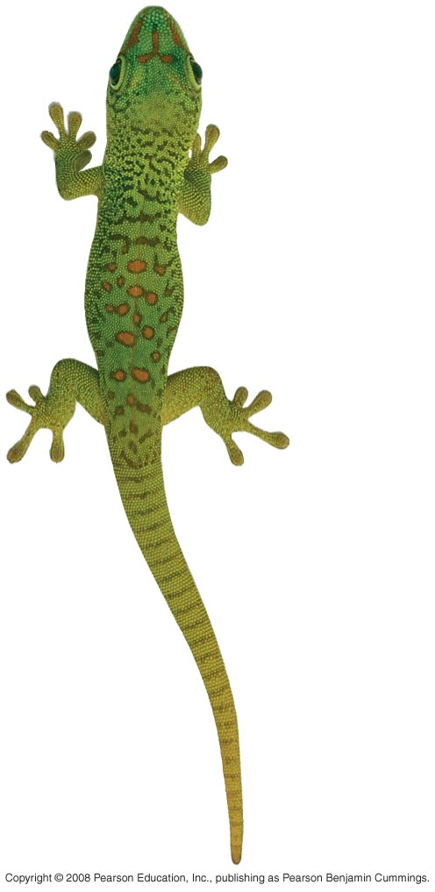
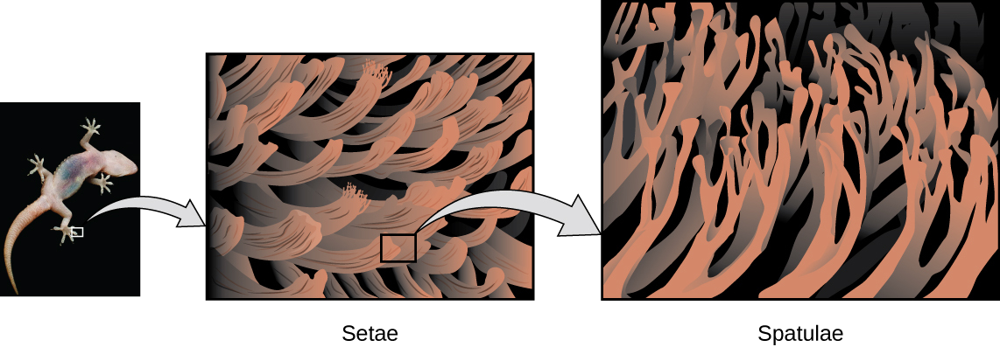
Intermolecular forces In nature
Collectively, intermolecular forces can be very strong
E.g. London forces between the molecules of a gecko’s toe hairs and a wall’s surface!
Ted Talk: https://tinyurl.com/5csv6abr
Gecko Adhesive fit for Spiderman:
https://youtu.be/gzm7yD-JuyM
Gecko Grip: https://www.youtube.com/watch?v=r5cqJTU5D5I
Notes:
The van der Waals interactions between the foot molecules and the molecules of the wall’s surface are so numerous that despite their individual weakness, together they can support the gecko’s body weight.
This discovery has inspired development of an artificial adhesive called Geckskin: A patch the size of an index card can hold a 700-pound weight to a wall!

Slide 25
Summary
In an atom, electrons occupy specific electron shells; the electrons in a shell have a characteristic energy level.
Electron distribution in shells determines the chemical behaviour of an atom. An atom that has an incomplete outer shell, the valence shell, is reactive.
An ion forms when an atom or molecule gains or loses an electron and becomes charged. An ionic bond is the attraction between two oppositely charged ions.
Molecules consist of two or more covalently bonded atoms.
The attraction of an atom for the electrons of a covalent bond is its electronegativity. If both atoms are the same, they have the same electronegativity and share a non-polar covalent bond. Electrons of a polar covalent bond are pulled closer to the more electronegative atom.
Intermolecular (van der Waals) interactions reinforce the shapes of large molecules and help molecules adhere to each other. A hydrogen bond is an attraction between a hydrogen atom carrying a partial positive charge (δ+) and an electronegative atom carrying a partial negative charge (δ-). Other interactions can occur between transiently positive and negative regions of molecules.

